Slide 1
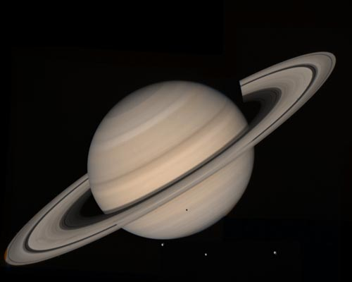
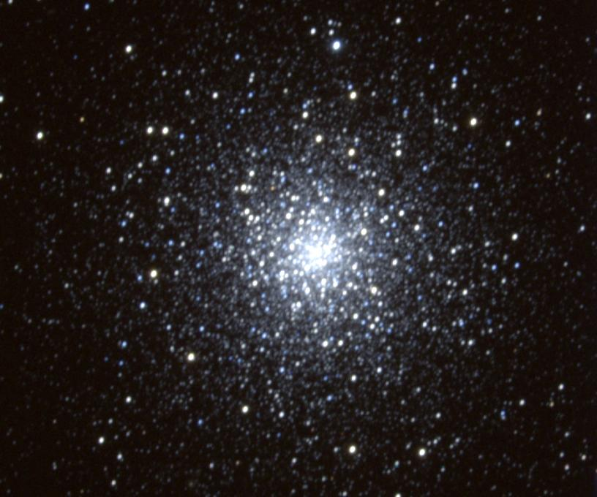
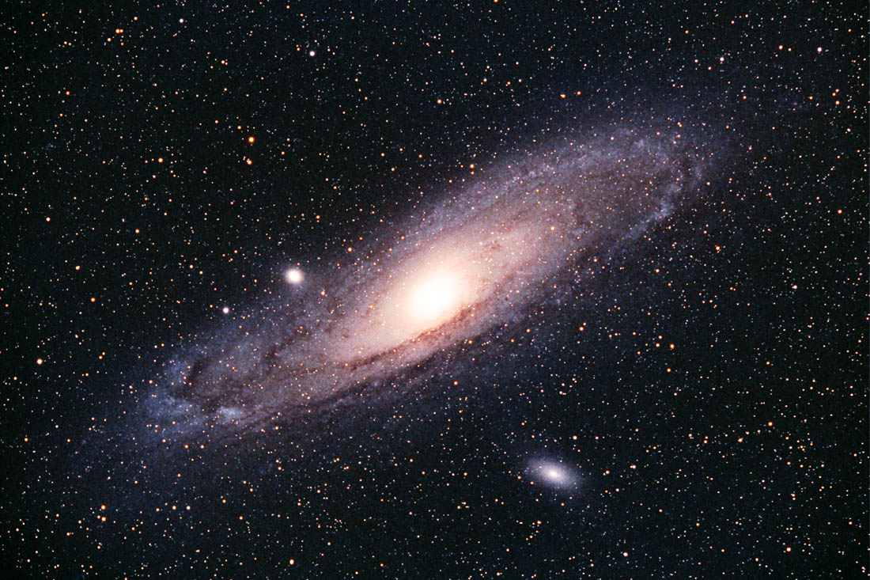
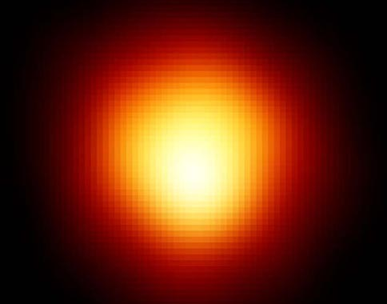
Black Holes in Space
Zeta Bootis

Slide 2
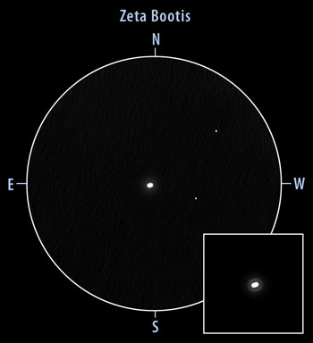
Zeta Bootis through the Telescope
This is a multiple star - two (or more) stars orbiting each over.
Currently, they are so close to each other that they appear to be one elongated star.

Slide 3
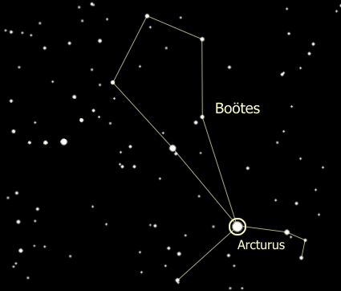
Zeta Bootis in the Night Sky
This binary star is found in the constellation Bootes (The Herdsman)
to the left of the red giant star Arcturus.
Zeta Bootis

Slide 4
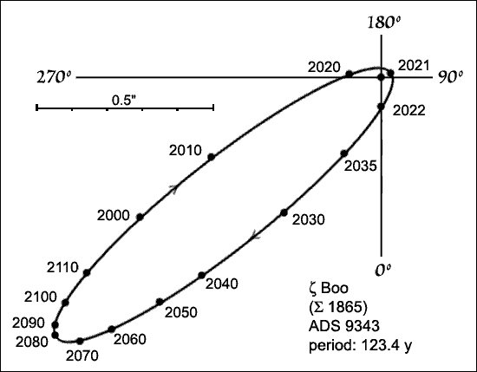
Zeta Bootis Orbits
The orbit of these two stars could set a record … it is very elongated.
Zeta Bootis A
Orbit of Zeta Bootis B

Slide 5
Zeta Bootis Orbits
At their farthest, the two stars are 60 times the Earth-Sun distance apart or 60 AU. At their closest, they are about as close as Mars is to the Sun (1.5 AU).
They will be at their
closest in 2021 and
at their farthest in 2082.
Current position

Slide 6
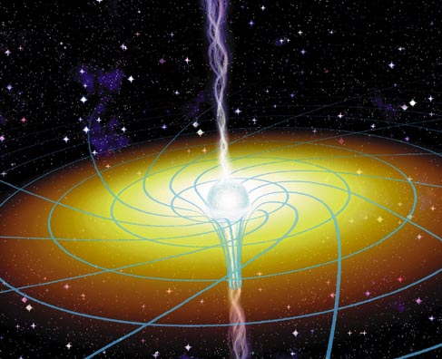
Black Holes
A black hole is an object with such strong gravity that in order to escape it you would have to travel faster than the speed of light (186,000 mi / sec).
Since nothing can travel that fast, even light itself can never escape a Black Hole.

Slide 7
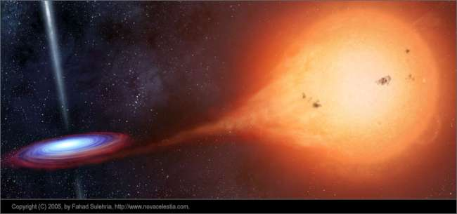
Evidence of Black Holes
The first step in looking for a stellar-mass black hole is to locate a source of X-Rays in space.

Slide 8
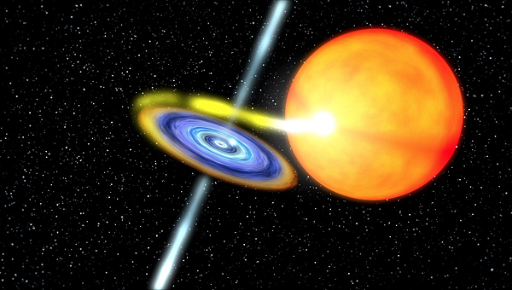
Evidence of Black Holes
If the X-Rays are associated with an ordinary star it is suspicious ... ordinary stars do not emit X-rays. Further study of the suspect “star” usually reveals an unseen companion.

Slide 9
Evidence of Black Holes
If the unseen companion is found to have a mass greater than 3 times that of our Sun then it must be a black hole.
The X-rays are produced when material from the companion star is drawn into the black hole.

Slide 10
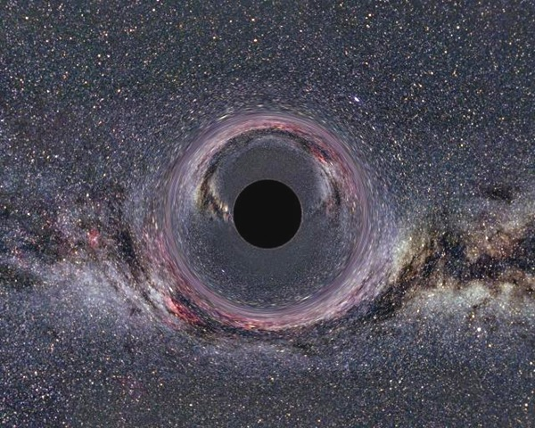
Evidence of Black Holes
Not all black holes exist in binary systems. Lone stellar-mass black holes do not have gas falling into them, and will not emit x-rays. Without the x-ray emission, they are very difficult to detect.

